Slide 1
Lecture 13: Introduction to Computer Programming Course - CS1010
DEPARTMENT OF COMPUTER SCIENCE | 10/22/2019

Slide 2
Announcements
Exam 2 will now be on November 5th .
This is 2 Weeks from now.
Back exam will be posted by the end of this week.

Slide 3
Goals for today
Loops in general
While Loops
Problems on While Loops

Slide 4
What is a Loop
A loop is a fundamental programming technique that is used in writing programs.
In computer programming, a loop is a sequence of instructions that are repeated until a certain condition is reached.
For example
We need to get an item of data and/or change it,
Based on some condition it is checked whether a counter has reached a prescribed number.
If NOT, then the next instruction in the sequence is an instruction to return to the first instruction in the sequence and repeat the sequence.
If the condition is reached, the next instruction tells the execution to branch outside the loop.

Slide 5
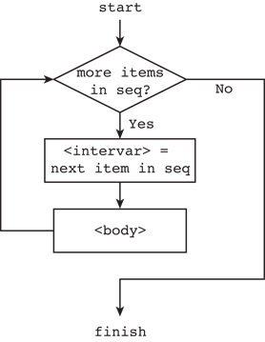
Loop Structure

Slide 6
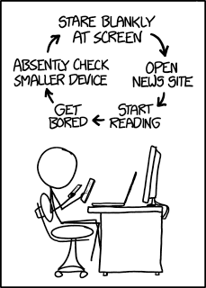
Why do we Loop?
Repetition
Generally used to access and modify information in a List
Allows us to repeat a block of code
Generally required for most sophisticated programming tasks

Slide 7
Types of Loops
While Loops: Test a condition
For Loops: Run for some pre-defined number of times
Iteration by index (Another form of for Loops)
Nested Loops

Slide 8
While Loops
Execution begins
Loop
While loop is used to run a block of code repeatedly until a given a condition is satisfied.
This repetition is referred to as iteration.
When the condition becomes false, the line immediately after the loop in the code is executed.
Condition
True
Block of Code
False
Rest of the Program

Slide 9
Syntax
while expression(s):
statements
Can be combined with else:
while condition(s):
statements
else:
statements
Python uses indentation as its method of grouping statements.

Slide 10
Python Program to Illustrate While Loop
General Procedure:
1. Initialize a counter variable
2. Specify the condition for while
3. Specify the required actions
4. Increment or Decrement the counter
Let’s check in spyder!

Slide 11
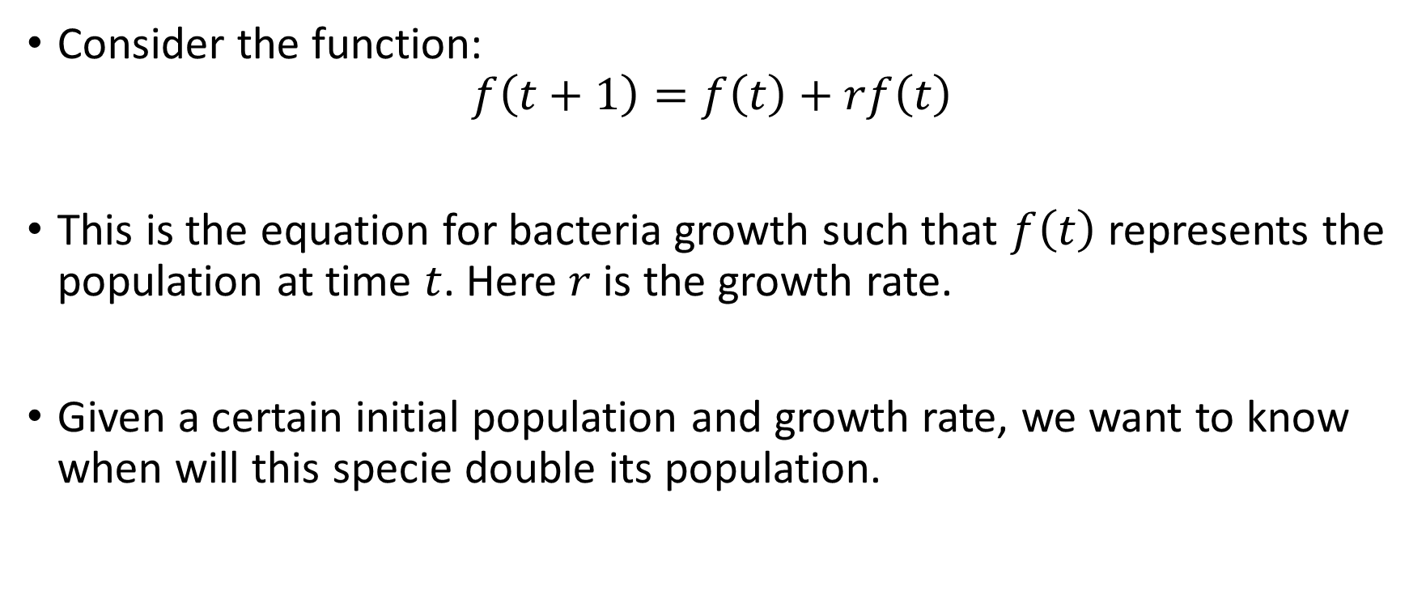
Calculation of Bacteria Growth Rate
Consider the function:
$$f\left(t+1\right)=f\left(t\right)+rf\left(t\right)$$
This is the equation for bacteria growth such that $f\left(t\right)$ represents the population at time $t$. Here $r$ is the growth rate.
Given a certain initial population and growth rate, we want to know when will this specie double its population.

Slide 12
Insights from Results
Time was updated inside the loop so its value is the value from the last iteration.
Loop condition was population<2000:
The variable population exceeded 2000 within the loop
In the next iteration i.e. when the variable exceeded 2000, the execution stopped
What if we want to stop exactly at 2000:
We can say in the condition:
while population == 2000
What is the issue in the above statement?

Slide 13
Infinite Loops
Execution can go on forever:
In Spyder Go to: Console push the red square to ‘kill’ the program
When deciding for loop condition be careful of the execution
Try to avoid infinite loops
# DO NOT RUN THIS CODE!!!!
while True:
print("I'm stuck in an infinite loop!")

Slide 14
Loops with Lists
We use loops to repeat a specific operation on every element of a list.
Given a list of velocities of different falling objects in metric unit (m/sec):
Velocities = [0.0, 9.81, 19.62, 29.43]
Covert these to ft per second (multiply by 3.28). The index of the lists specifies the object.
Print the new output for every object.

Slide 15
Controlling Loops
The basic rule is that all code within the body of a loop is executed.
Python provides controlling of Loop iteration using the following statements:
Break
Continue
Pass

Slide 16
Controlling Loops
break, continue, and pass statements are used in loops to add additional functionality for various cases.
These three statements are defined as:
break: Breaks control out of the current next enclosing loop.
continue: Takes control to the top of the next enclosing loop.
pass: Does nothing at all.

Slide 17
Controlling Loops Continued…
break and continue statements can appear anywhere inside the loop’s body.
We usually put them further nested in conjunction with an if statement to perform an action based on some condition.
Check in Spyder!
while test:
code statement
if test:
break
if test:
continue
else:

Slide 18
Flowchart of Break and Continue

Slide 19
More Examples of break and continue
Problem 1(a)
Write a while statement that
prints integers from zero to 5.
Problem 1(b)
Write a while statement that
outputs only odd integers
from 0 to 10.

Slide 20
Nested While
Just like if statements we can have Nested While statements
Output of the program on the right?
For every value in L the rest of the values will be repeated
Let’s check
L = [2, 21, 12, 8, 5, 31]
i = 0
while i < len(L):
j = 0
while j < len(L):
print(L[i], L[j])
j += 1
i += 1

Slide 21
Problem 1
Write a Python program to count the number of even and odd numbers from a series of numbers.
Sample numbers : numbers = [1, 2, 3, 4, 5, 6, 7, 8, 9]
Expected Output : Number of even numbers : 5 Number of odd numbers : 4

Slide 22
Problem 2
Given a list of numbers; print the numbers and find their sum.
Solution: Loop through the numbers.
Keep track of the sum in each iteration using a variable.

Slide 23
Problem 3
Write a Python program to find those numbers which are divisible by 7 and multiple of 5, between 1500 and 2700 (both included).
Solution:
Loop through all elements in the given range
Check divisibility by 5 and 7
Output the elements that fulfill the condition

Slide 24
Problem 4
The following list represents the population of New York State (in hundreds of thousands of people) for the US Census in 1790, 1800, 1810, etc., all the way through 2010.
census = [ 340, 589, 959, 1372, 1918, 2428, 3097, 3880, 4382, 5082, \
5997, 7268, 9113, 10385, 12588, 13479, 14830, 16782, \
8236, 17558, 17990, 18976, 19378 ]
Write code to find the average percentage change from one decade to the next, across all decades. For example, the change from 1790 to 1800 is (589 - 340) / 340 * 100 = 73.2% and the change from 1800 to 1810 is (959 - 589) / 589 * 100 = 62.8% so the average across just these two decades is 68.0%.

Slide 25
Problem 5:Example of nested loop
*
* *
* * *
* * * *
* * * * *
* * * *
* * *
* *
*
Write a Python program to construct the following pattern, using a nested loop.

Slide 26
Solution
Break the solution into two parts:
The upper triangle
The lower triangle
Think of two variables:
The lines containing stars
The stars themselves
Loop both the variables
Increment for the first(upper) triangle
Decrement for the second (lower) triangle

Slide 27
Next Class
Problems on While Loops
In Class exercise

